Slide 1
Data Binning
By Or Dinar, Liad Ackerman and Maayan Ben Zion
Guided by Dr. Adi Akavia

Slide 2
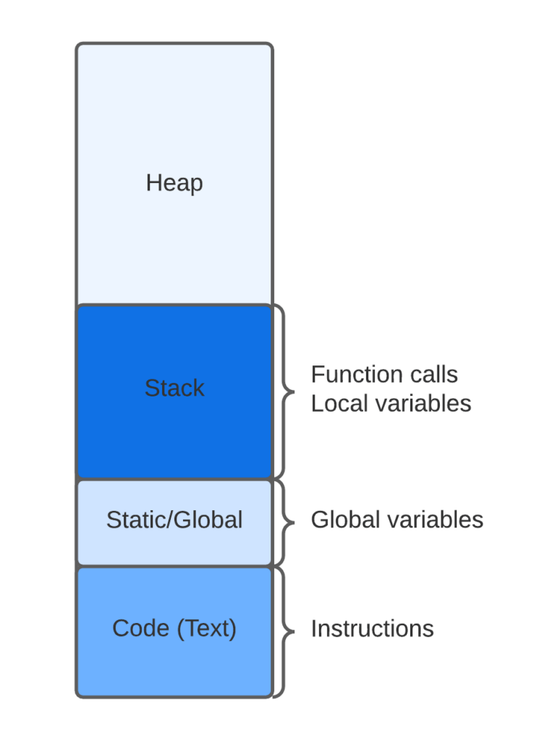

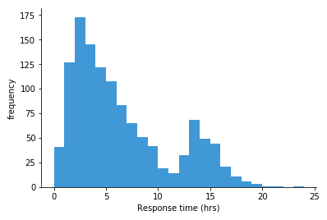
Topics
Balanced Allocation
Cuckoo Hashing
Data Binning

Slide 3
Data Generalization
Data generalisation involves sorting sensitive columns into bins or groups for analysis, removing specifics and creating a more generalised view. This technique, in combination with other pseudonymisation methods, is particularly effective for large datasets.
Balanced Allocation
Cuckoo Hashing
Data Binning

Slide 4
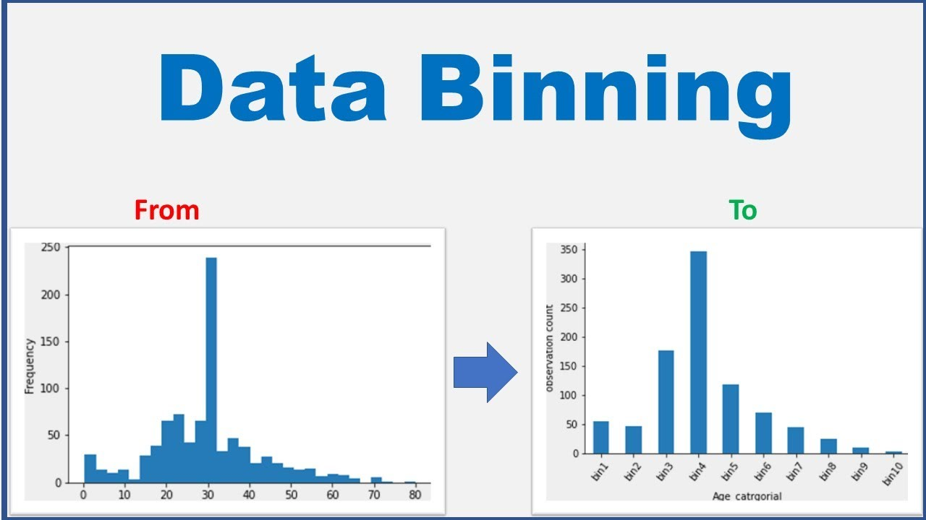
Definition of Data Binning
‘Discretization or “binning” is a common form of data preprocessing, aimed at grouping continuous or numerical values into a smaller number of bins (buckets).’
Balanced Allocation
Cuckoo Hashing
Data Binning

Slide 5
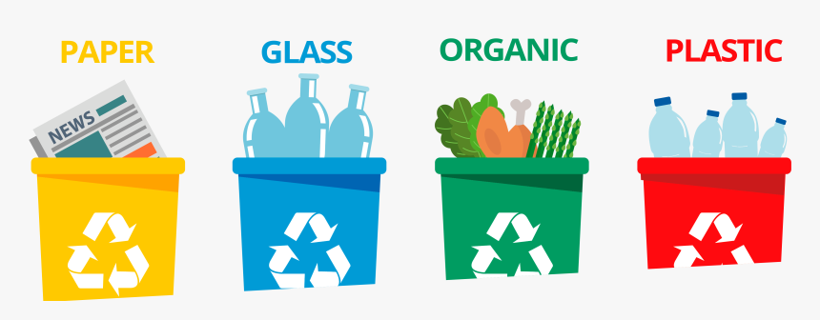
Examples of Data Binning
Balanced Allocation
Cuckoo Hashing
Data Binning
Recycling:
Glass
Plastic
Paper
Organic
Metals
Electronic Waste

Slide 6
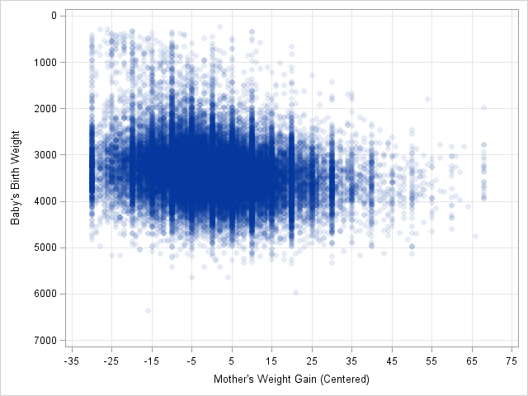
Examples of Data Binning
Balanced Allocation
Cuckoo Hashing
Data Binning
Binning an extensive amount of data into discrete values
in a 2D model

Slide 7
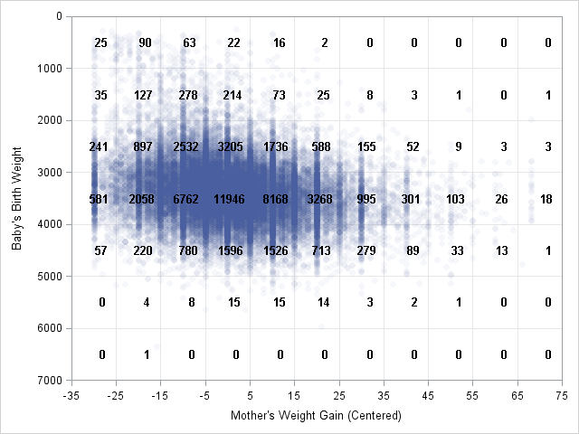
Examples of Data Binning
Balanced Allocation
Cuckoo Hashing
Data Binning
Binning an extensive amount of data into discrete values
in a 2D model

Slide 8
Steps
Balanced Allocation
Cuckoo Hashing
Data Binning
1
Identify the range of all values
2
Choose a suitable Binning method
3
Choose the amount of bins
4
Sort the data in the defined range
5
Analyze the data

Slide 9


Types of Binning
Balanced Allocation
Cuckoo Hashing
Data Binning
Supervised Binning
Unsupervised Binning

Slide 10
Common Binning methods
Balanced Allocation
Cuckoo Hashing
Data Binning
Equal-Width Binning
Equal-Frequency Binning
Entropy-Based Binning
Custom Binning
Quantile Binning
Optimal Binning

Slide 11
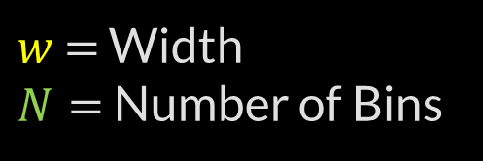
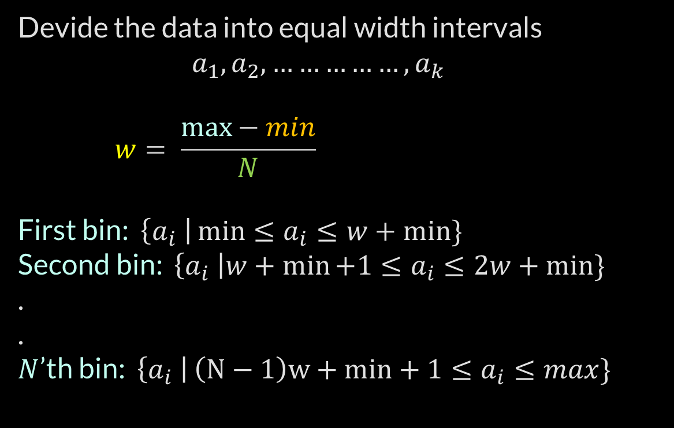
Equal-Width Binning
Balanced Allocation
Cuckoo Hashing
Data Binning
Devide the data into equal width intervals
$$a_{1},a_{2}, ……………,a_{k }$$
$$w= \frac{\max{− min}}{N}$$
First bin: $\left\{a_{i} \right|\min{≤a_{i}≤w+min\}}$
Second bin: $\left\{a_{i} \right|w+\min{+1≤a_{i}≤2w+min\}}$
.
.
$N$’th bin: $\left\{a_{i} \right|\left(N−1\right)w+min+1{≤a_{i}≤max\}}$
$w$ $=$ Width
$N=$ Number of Bins

Slide 12
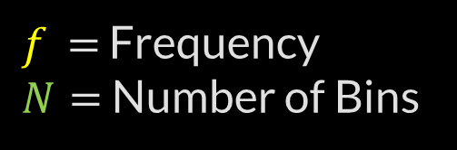
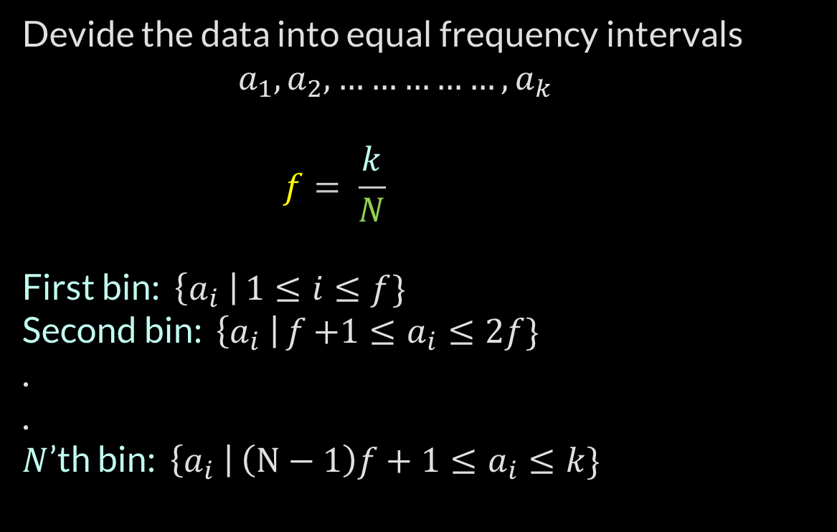
Equal-Frequency Binning
Balanced Allocation
Cuckoo Hashing
Data Binning
Devide the data into equal frequency intervals
$$a_{1},a_{2}, ……………,a_{k }$$
$$f= \frac{k}{N}$$
First bin: $\left\{a_{i} \right|1{≤i≤f\}}$
Second bin: $\left\{a_{i} \right|f{+1≤a_{i}≤2f\}}$
.
.
$N$’th bin: $\left\{a_{i} \right|\left(N−1\right)f+1{≤a_{i}≤k\}}$
$f$ $=$ Frequency
$N=$ Number of Bins

Slide 13

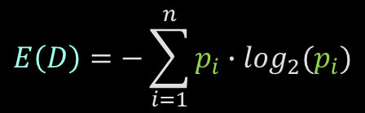
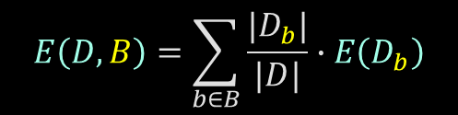
Entropy-Based Binning
Balanced Allocation
Cuckoo Hashing
Data Binning
find bin boundaries that maximize the information gain or minimize the uncertainty within each bin.
Calculate Entropy:
2. Calculate Entropy given a bin:
3. Calculate Information gain:
$$E\left(D\right)=−\sum_{i=1}^{n}{p_{i}∙\log_{2}(p_{i})}$$
$$E\left(D,B\right)=\sum_{b∈B}{\frac{{|D}_{b}|}{|D|}∙E\left(D_{b}\right)}$$
$$IG= E\left(D\right)−E\left(D,B\right)$$

Slide 14
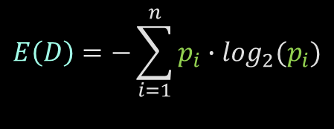
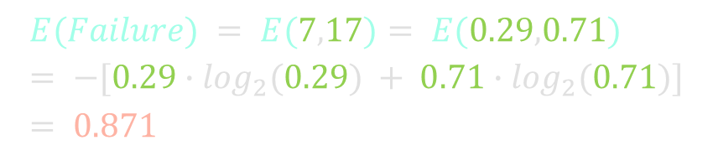
Entropy-Based Binning
Balanced Allocation
Cuckoo Hashing
Data Binning
O-Ring Failure | Temperature
Y | 53
Y | 56
Y | 57
N | 63
N | 66
N | 67
N | 67
N | 67
N | 68
N | 69
N | 70
Y | 70
Y | 70
Y | 70
N | 72
N | 73
N | 75
Y | 75
N | 76
N | 76
N | 78
N | 79
N | 80
N | 81
Calculate Entropy:
$$E\left(D\right)=−\sum_{i=1}^{n}{p_{i}∙\log_{2}(p_{i})}$$
O-Ring Failure
Y | N
7 | 17
$$E(Failure) = E(7,17)= E(0.29,0.71) = −[0.29∙\log_{2}⁡(0.29) + 0.71∙\log_{2}⁡(0.71)]= 0.871$$

Slide 15
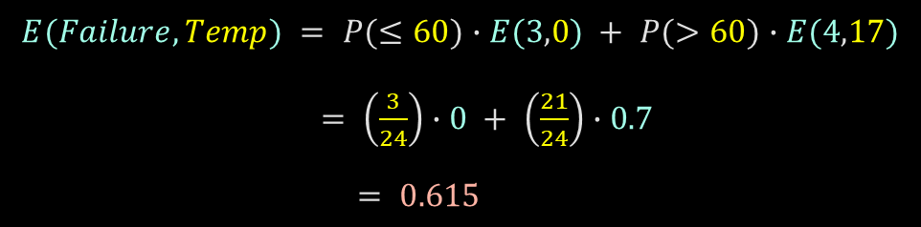
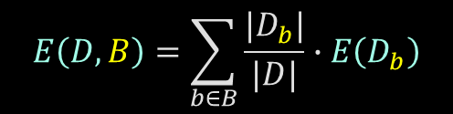
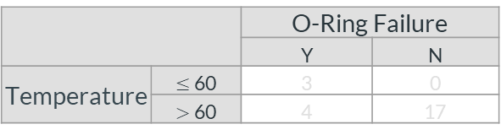
Entropy-Based Binning
Balanced Allocation
Cuckoo Hashing
Data Binning
2. Calculate Entropy given a bin:
O-Ring Failure | Temperature
Y | 53
Y | 56
Y | 57
N | 63
N | 66
N | 67
N | 67
N | 67
N | 68
N | 69
N | 70
Y | 70
Y | 70
Y | 70
N | 72
N | 73
N | 75
Y | 75
N | 76
N | 76
N | 78
N | 79
N | 80
N | 81
$$E\left(D,B\right)=\sum_{b∈B}{\frac{{|D}_{b}|}{|D|}∙E\left(D_{b}\right)}$$
 |  | O-Ring Failure
 |  | Y | N
Temperature | $≤$60 | 3 | 0
 | $>$60 | 4 | 17
$$E(Failure,Temp) = P(≤60)∙E(3,0) + P(>60)∙E(4,17)$$
$= \left(\frac{3}{24}\right)∙0 + \left(\frac{21}{24}\right)∙0.7$
$= 0.615$

Slide 16
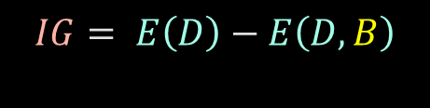
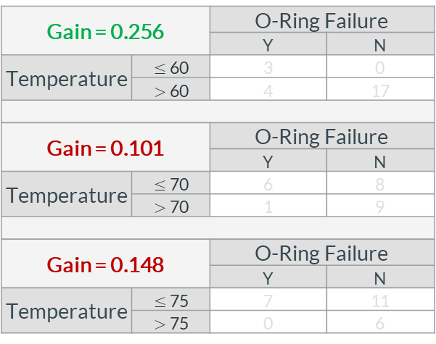
Entropy-Based Binning
Balanced Allocation
Cuckoo Hashing
Data Binning
3. Calculate Information gain:
O-Ring Failure | Temperature
Y | 53
Y | 56
Y | 57
N | 63
N | 66
N | 67
N | 67
N | 67
N | 68
N | 69
N | 70
Y | 70
Y | 70
Y | 70
N | 72
N | 73
N | 75
Y | 75
N | 76
N | 76
N | 78
N | 79
N | 80
N | 81
$$IG= E\left(D\right)−E\left(D,B\right)$$
Gain = 0.256 |  | O-Ring Failure
 |  | Y | N
Temperature | $≤$60 | 3 | 0
 | $>$60 | 4 | 17
Gain = 0.101 |  | O-Ring Failure
 |  | Y | N
Temperature | $≤$70 | 6 | 8
 | $>$70 | 1 | 9
Gain = 0.148 |  | O-Ring Failure
 |  | Y | N
Temperature | $≤$75 | 7 | 11
 | $>$75 | 0 | 6

Slide 17
Cuckoo Hashing
Balanced Allocation
Data Binning
Cuckoo Hashing

Slide 18
Hashing
Balanced Allocation
Data Binning
Cuckoo Hashing
Keys
Hash Function
Hash Table
0
John
1
John
2
Moshe
Moshe
3
Abraham
Abraham
4
Boris
5
Boris
6
7

Slide 19
Hashing
Balanced Allocation
Data Binning
Cuckoo Hashing
Keys
Hash Function
Hash Table
Abraham
0
John
1
2
Moshe
John
3
Abraham
4
Boris
5
6
Moshe
7
Boris

Slide 20
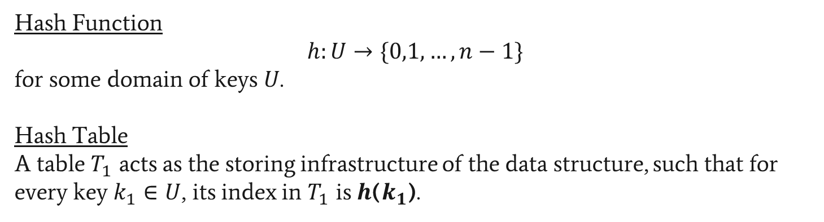
Hashing
Balanced Allocation
Data Binning
Cuckoo Hashing
Hash Function
$$h:U→\{0,1,…,n−1\}$$
for some domain of keys $U$.
Hash Table
A table $T_{1}$ acts as the storing infrastructure of the data structure, such that for every key $k_{1}∈U$, its index in $T_{1}$ is $h$($k_{1}$).

Slide 21



Hashing - Operations
Balanced Allocation
Data Binning
Cuckoo Hashing
Insert
Lookup
Delete
All operations’ complexity is O(n) when using Linked Lists
All operations’ complexity is O(logn) when using BST
Amortized complexity is O(1)

Slide 22
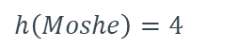
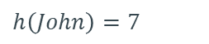
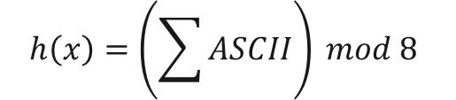
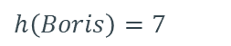
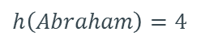
Hashing - Example
Balanced Allocation
Data Binning
Cuckoo Hashing
Keys
Hash Function
Hash Table
0
$$h\left(John\right)=7$$
John
1
2
$$h\left(Moshe\right)=4$$
Moshe
3
$$h\left(Abraham\right)=4$$
Abraham
4
$$h\left(Boris\right)=7$$
Boris
5
6
7
$$h\left(x\right)=\left(\sum{ASCII}\right) mod 8$$

Slide 23
Hashing - Example
Balanced Allocation
Data Binning
Cuckoo Hashing
Keys
Hash Function
Hash Table
Insert(John)
0
$$h\left(John\right)=7$$
John
1
2
$$h\left(Moshe\right)=4$$
Moshe
3
$$h\left(Abraham\right)=4$$
Abraham
4
$$h\left(Boris\right)=7$$
Boris
5
6
John
7
$$h\left(x\right)=\left(\sum{ASCII}\right) mod 8$$

Slide 24
Hashing - Example
Balanced Allocation
Data Binning
Cuckoo Hashing
Keys
Hash Function
Hash Table
Insert(Moshe)
0
$$h\left(John\right)=7$$
John
1
2
$$h\left(Moshe\right)=4$$
Moshe
3
$$h\left(Abraham\right)=4$$
Abraham
4
Moshe
$$h\left(Boris\right)=7$$
Boris
5
6
John
7
$$h\left(x\right)=\left(\sum{ASCII}\right) mod 8$$

Slide 25
Hashing - Example
Balanced Allocation
Data Binning
Cuckoo Hashing
Keys
Hash Function
Hash Table
Insert(Abraham)
0
$$h\left(John\right)=7$$
John
1
2
$$h\left(Moshe\right)=4$$
Moshe
3
$$h\left(Abraham\right)=4$$
Abraham
Abraham
4
Moshe
$$h\left(Boris\right)=7$$
Boris
5
6
John
7
$$h\left(x\right)=\left(\sum{ASCII}\right) mod 8$$

Slide 26
Hashing - Example
Balanced Allocation
Data Binning
Cuckoo Hashing
Keys
Hash Function
Hash Table
Insert(Boris)
0
$$h\left(John\right)=7$$
John
1
2
$$h\left(Moshe\right)=4$$
Moshe
3
$$h\left(Abraham\right)=4$$
Abraham
Abraham
4
Moshe
$$h\left(Boris\right)=7$$
Boris
5
6
7
Boris
John
$$h\left(x\right)=\left(\sum{ASCII}\right) mod 8$$

Slide 27
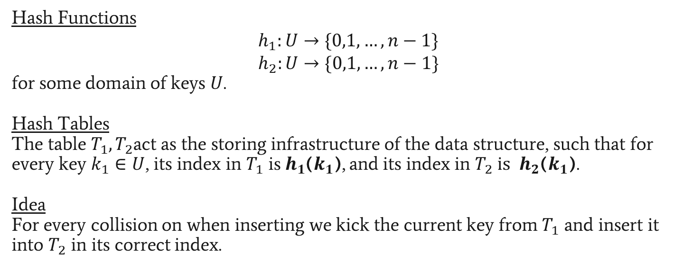
Cuckoo Hashing
Balanced Allocation
Data Binning
Cuckoo Hashing
Hash Functions
$$h_{1}:U→\{0,1,…,n−1\}$$
$$h_{2}:U→\{0,1,…,n−1\}$$
for some domain of keys $U$.
Hash Tables
The table $T_{1},T_{2}$act as the storing infrastructure of the data structure, such that for every key $k_{1}∈U$, its index in $T_{1}$ is$h_{1}$($k_{1}$), and its index in $T_{2} is$ $h_{2}$($k_{1}$).
Idea
For every collision on when inserting we kick the current key from $T_{1}$ and insert it into $T_{2}$ in its correct index.

Slide 28
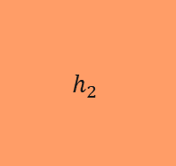



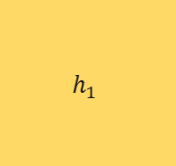



Cuckoo Hashing
Balanced Allocation
Data Binning
Cuckoo Hashing
Keys
Hash Functions
Hash Table 1
Hash Table 2
$$h_{1}$$
0
0
$$k_{1}$$
1
1
$$k_{2}$$
2
2
$$k_{3}$$
3
3
$$k_{4}$$
4
4
$$h_{2}$$
$$k_{5}$$
5
5
$$k_{6}$$
6
6
7
7

Slide 29
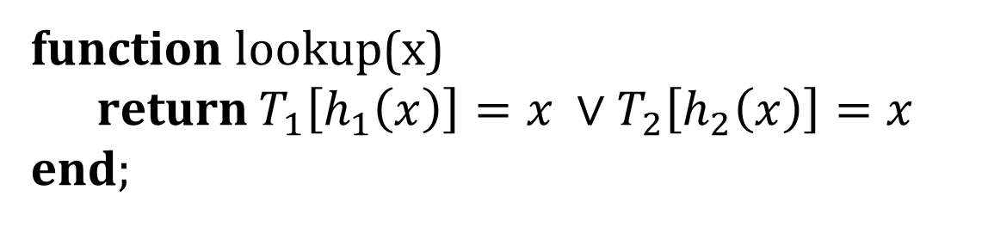
Cuckoo Hashing - Lookup
Balanced Allocation
Data Binning
Cuckoo Hashing
function lookup(x)
return $T_{1}\left[h_{1}\left(x\right)\right]=x ∨T_{2}\left[h_{2}\left(x\right)\right]=x$
end;

Slide 30
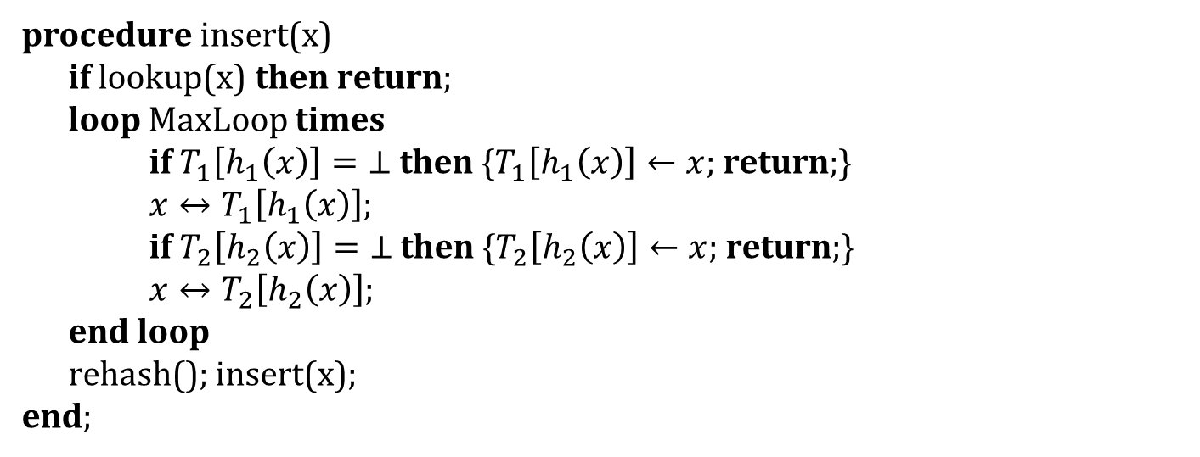
Cuckoo Hashing - Insert
Balanced Allocation
Data Binning
Cuckoo Hashing
procedure insert(x)
if lookup(x) then return;
loop MaxLoop times
if $T_{1}\left[h_{1}\left(x\right)\right]=\text{⊥}$ then {$T_{1}\left[h_{1}\left(x\right)\right]←x$; return;}
$x↔T_{1}\left[h_{1}\left(x\right)\right]$;
if $T_{2}\left[h_{2}\left(x\right)\right]=\text{⊥}$ then {$T_{2}\left[h_{2}\left(x\right)\right]←x$; return;}
$x↔T_{2}\left[h_{2}\left(x\right)\right]$;
end loop
rehash(); insert(x);
end;
*$x↔y$ expresses x and y are being swapped.

Slide 31
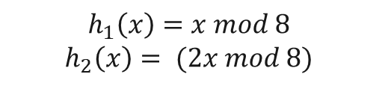
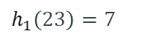
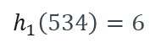
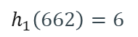
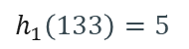
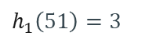
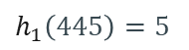
Cuckoo Hashing
Balanced Allocation
Data Binning
Cuckoo Hashing
Keys
Hash Functions
Hash Table 1
Hash Table 2
$$h_{1}\left(51\right)=3$$
51
$$h_{1}$$
0
0
1
1
$$h_{1}\left(133\right)=5$$
133
2
2
$$h_{1}\left(662\right)=6$$
662
3
3
$$h_{1}\left(534\right)=6$$
534
$$h_{2}$$
4
4
5
5
$$h_{1}\left(23\right)=7$$
23
6
6
$$h_{1}\left(445\right)=5$$
445
7
7
$$h_{1}\left(x\right)=x mod 8$$
$$h_{2}\left(x\right)= (2x mod 8)$$

Slide 32
Cuckoo Hashing
Balanced Allocation
Data Binning
Cuckoo Hashing
Keys
Hash Functions
Hash Table 1
Hash Table 2
Insert(534)
$$h_{1}\left(51\right)=3$$
51
$$h_{1}$$
0
0
1
1
$$h_{1}\left(133\right)=5$$
133
2
2
$$h_{1}\left(662\right)=6$$
662
51
3
3
$$h_{1}\left(534\right)=6$$
534
4
4
534
$$h_{2}$$
5
5
133
$$h_{1}\left(23\right)=7$$
23
6
6
662
$$h_{1}\left(445\right)=5$$
445
7
7
Collision
$$h_{1}\left(x\right)=x mod 8$$
$$h_{2}\left(x\right)= (2x mod 8)$$

Slide 33
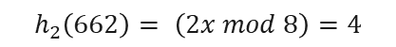
Cuckoo Hashing
Balanced Allocation
Data Binning
Cuckoo Hashing
Keys
Hash Functions
Hash Table 1
Hash Table 2
Insert(534)
$$h_{1}\left(51\right)=3$$
51
$$h_{1}$$
0
0
1
1
$$h_{1}\left(133\right)=5$$
133
2
2
$$h_{1}\left(662\right)=6$$
662
51
3
3
$$h_{1}\left(534\right)=6$$
534
$$h_{2}$$
4
4
5
5
133
$$h_{1}\left(23\right)=7$$
23
6
6
534
$$h_{1}\left(445\right)=5$$
445
7
7
Collision
$$h_{2}\left(662\right)= \left(2x mod 8\right)=4$$
$$h_{1}\left(x\right)=x mod 8$$
$$h_{2}\left(x\right)= (2x mod 8)$$
662

Slide 34
Cuckoo Hashing
Balanced Allocation
Data Binning
Cuckoo Hashing
Keys
Hash Functions
Hash Table 1
Hash Table 2
Insert(534)
$$h_{1}\left(51\right)=3$$
51
$$h_{1}$$
0
0
1
1
$$h_{1}\left(133\right)=5$$
133
2
2
$$h_{1}\left(662\right)=6$$
662
51
3
3
4
4
$$h_{1}\left(534\right)=6$$
534
$$h_{2}$$
662
5
5
133
$$h_{1}\left(23\right)=7$$
23
6
6
534
$$h_{1}\left(445\right)=5$$
445
7
7
Collision
$$h_{2}\left(662\right)= \left(2x mod 8\right)=4$$
$$h_{1}\left(x\right)=x mod 8$$
$$h_{2}\left(x\right)= (2x mod 8)$$

Slide 35
Cuckoo Hashing
Balanced Allocation
Data Binning
Cuckoo Hashing
Keys
Hash Functions
Hash Table 1
Hash Table 2
Insert(23)
$$h_{1}\left(51\right)=3$$
51
$$h_{1}$$
0
0
1
1
$$h_{1}\left(133\right)=5$$
133
2
2
$$h_{1}\left(662\right)=6$$
662
51
3
3
4
4
$$h_{1}\left(534\right)=6$$
534
$$h_{2}$$
662
5
5
133
$$h_{1}\left(23\right)=7$$
23
6
6
534
$$h_{1}\left(445\right)=5$$
445
7
7
23
$$h_{1}\left(x\right)=x mod 8$$
$$h_{2}\left(x\right)= (2x mod 8)$$

Slide 36
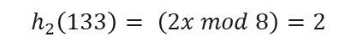
Cuckoo Hashing
Balanced Allocation
Data Binning
Cuckoo Hashing
Keys
Hash Functions
Hash Table 1
Hash Table 2
Insert(445)
$$h_{1}\left(51\right)=3$$
51
$$h_{1}$$
0
0
1
1
$$h_{1}\left(133\right)=5$$
133
2
2
$$h_{1}\left(662\right)=6$$
662
51
3
3
4
662
$$h_{1}\left(534\right)=6$$
534
$$h_{2}$$
4
5
5
445
$$h_{1}\left(23\right)=7$$
23
6
6
534
$$h_{1}\left(445\right)=5$$
445
7
7
23
Collision
$$h_{2}\left(133\right)= \left(2x mod 8\right)=2$$
$$h_{1}\left(x\right)=x mod 8$$
$$h_{2}\left(x\right)= (2x mod 8)$$
133

Slide 37
Cuckoo Hashing
Balanced Allocation
Data Binning
Cuckoo Hashing
Keys
Hash Functions
Hash Table 1
Hash Table 2
Insert(445)
$$h_{1}\left(51\right)=3$$
51
$$h_{1}$$
0
0
1
1
$$h_{1}\left(133\right)=5$$
133
2
133
2
$$h_{1}\left(662\right)=6$$
662
51
3
3
4
662
$$h_{1}\left(534\right)=6$$
534
$$h_{2}$$
4
5
5
445
$$h_{1}\left(23\right)=7$$
23
6
6
534
$$h_{1}\left(445\right)=5$$
445
7
7
23
Collision
$$h_{2}\left(133\right)= \left(2x mod 8\right)=2$$
$$h_{1}\left(x\right)=x mod 8$$
$$h_{2}\left(x\right)= (2x mod 8)$$

Slide 38
Cuckoo Hashing
Balanced Allocation
Data Binning
Cuckoo Hashing
Keys
Hash Functions
Hash Table 1
Hash Table 2
$$h_{1}\left(51\right)=3$$
51
$$h_{1}$$
0
0
1
1
$$h_{1}\left(133\right)=5$$
133
2
133
2
$$h_{1}\left(662\right)=6$$
662
51
3
3
4
662
$$h_{1}\left(534\right)=6$$
534
$$h_{2}$$
4
5
5
445
$$h_{1}\left(23\right)=7$$
23
6
6
534
$$h_{1}\left(445\right)=5$$
445
7
7
23
$$h_{1}\left(x\right)=x mod 8$$
$$h_{2}\left(x\right)= (2x mod 8)$$

Slide 39
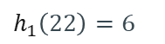
Cuckoo Hashing
Balanced Allocation
Data Binning
Cuckoo Hashing
Keys
Hash Functions
Hash Table 1
Hash Table 2
$$h_{1}\left(51\right)=3$$
51
$$h_{1}$$
0
0
1
1
$$h_{1}\left(133\right)=5$$
133
2
133
2
$$h_{1}\left(662\right)=6$$
662
51
3
3
4
662
$$h_{1}\left(534\right)=6$$
534
$$h_{2}$$
4
5
5
445
$$h_{1}\left(23\right)=7$$
23
6
6
534
534
$$h_{1}\left(445\right)=5$$
445
7
7
23
$$h_{1}\left(22\right)=6$$
22
22
$$h_{1}\left(x\right)=x mod 8$$
$$h_{2}\left(x\right)= (2x mod 8)$$

Slide 40
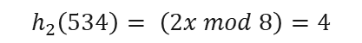
Cuckoo Hashing
Balanced Allocation
Data Binning
Cuckoo Hashing
Keys
Hash Functions
Hash Table 1
Hash Table 2
Insert(445)
$$h_{1}\left(51\right)=3$$
51
$$h_{1}$$
0
0
1
1
$$h_{1}\left(133\right)=5$$
133
2
133
2
$$h_{1}\left(662\right)=6$$
662
51
3
3
4
4
662
$$h_{1}\left(534\right)=6$$
534
$$h_{2}$$
662
5
5
445
$$h_{1}\left(23\right)=7$$
23
6
6
22
$$h_{1}\left(445\right)=5$$
445
7
7
23
$$h_{1}\left(22\right)=6$$
22
$$h_{2}\left(534\right)= \left(2x mod 8\right)=4$$
$$h_{1}\left(x\right)=x mod 8$$
$$h_{2}\left(x\right)= (2x mod 8)$$
Collision
534

Slide 41

Cuckoo Hashing
Balanced Allocation
Data Binning
Cuckoo Hashing
Keys
Hash Functions
Hash Table 1
Hash Table 2
Insert(445)
$$h_{1}\left(51\right)=3$$
51
$$h_{1}$$
0
0
1
1
$$h_{1}\left(133\right)=5$$
133
2
133
2
$$h_{1}\left(662\right)=6$$
662
51
3
3
4
534
4
$$h_{1}\left(534\right)=6$$
534
$$h_{2}$$
662
5
5
445
$$h_{1}\left(23\right)=7$$
23
6
6
22
$$h_{1}\left(445\right)=5$$
445
7
7
23
$$h_{1}\left(22\right)=6$$
22
$$h_{1}\left(662\right)= \left(x mod 8\right)=6$$
$$h_{1}\left(x\right)=x mod 8$$
$$h_{2}\left(x\right)= (2x mod 8)$$
Collision
662

Slide 42
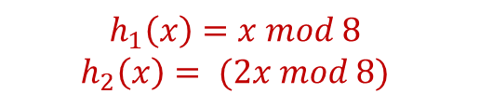

Cuckoo Hashing
Balanced Allocation
Data Binning
Cuckoo Hashing
Keys
Hash Functions
Hash Table 1
Hash Table 2
Insert(445)
$$h_{1}\left(51\right)=3$$
51
$$h_{1}$$
0
0
1
1
$$h_{1}\left(133\right)=5$$
133
2
133
2
$$h_{1}\left(662\right)=6$$
662
51
3
3
4
534
4
$$h_{1}\left(534\right)=6$$
534
$$h_{2}$$
662
5
5
445
$$h_{1}\left(23\right)=7$$
23
6
6
22
$$h_{1}\left(445\right)=5$$
445
7
7
23
$$h_{1}\left(22\right)=6$$
22
$$h_{1}\left(662\right)= \left(x mod 8\right)=6$$
$$h_{1}\left(x\right)=x mod 8$$
$$h_{2}\left(x\right)= (2x mod 8)$$
Collision
662

Slide 43
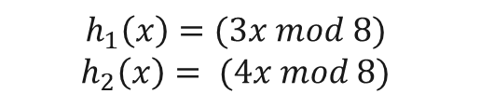
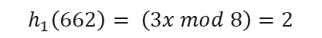
Cuckoo Hashing
Balanced Allocation
Data Binning
Cuckoo Hashing
Keys
Hash Functions
Hash Table 1
Hash Table 2
Insert(445)
$$h_{1}\left(51\right)=3$$
51
$$h_{1}$$
0
0
1
1
$$h_{1}\left(133\right)=5$$
133
2
133
2
$$h_{1}\left(662\right)=6$$
662
51
3
3
4
534
4
$$h_{1}\left(534\right)=6$$
534
$$h_{2}$$
662
5
5
445
$$h_{1}\left(23\right)=7$$
23
6
6
22
$$h_{1}\left(445\right)=5$$
445
7
7
23
$$h_{1}\left(22\right)=6$$
22
$$h_{1}\left(662\right)= \left(3x mod 8\right)=2$$
$$h_{1}\left(x\right)=(3x mod 8)$$
$$h_{2}\left(x\right)= (4x mod 8)$$
662

Slide 44
Cuckoo Hashing
Balanced Allocation
Data Binning
Cuckoo Hashing
Keys
Hash Functions
Hash Table 1
Hash Table 2
Insert(445)
$$h_{1}\left(51\right)=3$$
51
$$h_{1}$$
0
0
1
1
$$h_{1}\left(133\right)=5$$
133
2
133
662
2
$$h_{1}\left(662\right)=6$$
662
51
3
3
4
534
4
$$h_{1}\left(534\right)=6$$
534
$$h_{2}$$
662
5
5
445
$$h_{1}\left(23\right)=7$$
23
6
6
22
$$h_{1}\left(445\right)=5$$
445
7
7
23
$$h_{1}\left(22\right)=6$$
22
$$h_{1}\left(662\right)= \left(3x mod 8\right)=2$$
$$h_{1}\left(x\right)=(3x mod 8)$$
$$h_{2}\left(x\right)= (4x mod 8)$$

Slide 45
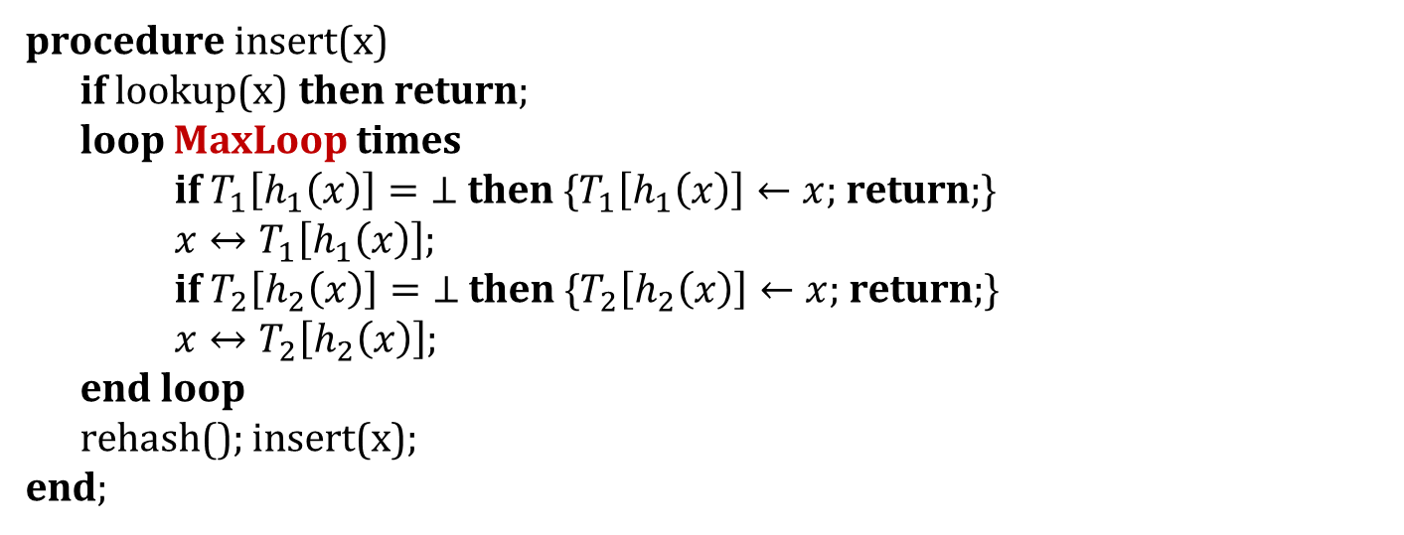
Cuckoo Hashing - Insert
Balanced Allocation
Data Binning
Cuckoo Hashing
procedure insert(x)
if lookup(x) then return;
loop MaxLoop times
if $T_{1}\left[h_{1}\left(x\right)\right]=\text{⊥}$ then {$T_{1}\left[h_{1}\left(x\right)\right]←x$; return;}
$x↔T_{1}\left[h_{1}\left(x\right)\right]$;
if $T_{2}\left[h_{2}\left(x\right)\right]=\text{⊥}$ then {$T_{2}\left[h_{2}\left(x\right)\right]←x$; return;}
$x↔T_{2}\left[h_{2}\left(x\right)\right]$;
end loop
rehash(); insert(x);
end;
How do we choose MaxLoop?
*$x↔y$ expresses x and y are being swapped.

Slide 46
Cuckoo Hashing - Time Complexity
Balanced Allocation
Data Binning
Cuckoo Hashing
Search and delete are O(1) in the worst case.
constant number of “nests”
Insert has amortized cost of O(1)
worst case is still O(n) due to rehash
worst case of number of evictions is O(logn)

Slide 47
Balanced Allocation
Cuckoo Hashing
Data Binning
Balanced Allocation

Slide 48
Balanced Allocation
As seen before, for cuckoo hashing, two items cannot be placed in the same bin so the existing item is kicked and placed into the other table.
balanced allocation is a technique used to divide k elements into m = k/ln(ln(k)) bins in which each bin has at most O(ln(ln(k)) items with very high probability (different from the cuckoo because we can put multiple items into one bin).
How is it done? Each time we insert an element we choose 2 random bins (using hash over uniform distribution) and put it in the bin that is less full

Slide 49
Finite Process and Infinite Process
Finite Process
Infinite Process
The Finite Process goes where each time a task comes it given d options and unknown “death”
In the Infinite Process At each iteration 2 indices are selected randomly The first ball get deleted and then we insert the second one.
For analysis we define to the problem as that we are given n servers with requests we don’t know when the request will end. and we want to minimize the load on each server

Slide 50
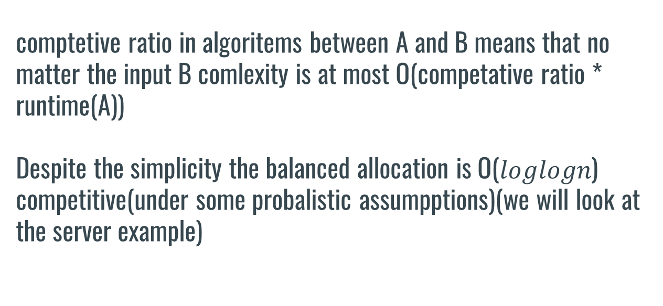
Balanced allocation
comptetive ratio in algoritems between A and B means that no matter the input B comlexity is at most O(competative ratio * runtime(A)) Despite the simplicity the balanced allocation is O($loglogn$) competitive(under some probalistic assumpptions)(we will look at the server example)

Slide 51
Let M be the total number of severs each task j has runtime $W\left(j\right)≥0, arrivale time T\left(j\right),set of severs he can use M\left(j\right)⊂M$ as soon as the task come we must chose one sever to run in onto and once assigned we cant take the task back we denote the load on sever i at time t in $L_{i}^{A}\left(t\right)=\sum_{i}^{n}{\left(W\left(i\right)\right)s.t task_{i}∈sever_{i}}$ using algoritem A let $σ$ be the sequence of arrivals and departures and $|σ|$ be the time of the last arrival
prove

Slide 52
The cost of an assignment is $C_{A}\left(σ\right)=\max_{0≤t≤\left|σ\right|:i∈M}{L_{i}(t)}$ Theorem -$The maximum load achieved by GREEDY on a random \left(n, n, 2\right)−problem is less than\frac{lnln\left(n\right)}{ln2} + O\left(1\right)with high probability.$ $$h_{t} denote the hight of ball at time t meaning it equall to the number of taks at time i in \\ the bin , v_{i}\left(t\right) denote the number of bins with more than i tasks at time t$$ because the taks are independt $\operatorname{Pr}\left(h_{t}≥i+1 | v_{≥i }\left(t−1\right)\right)=\frac{{\left(v_{≥i}\left(t−1\right)\right)}^{2}}{n^{2}}$ now lets denotae $ε_{i}$ be the event that $v_{≥i}\left(n\right)<β_{i}$ $$Y_{t}=1 iff h_{t}≥i+1 and v_{\left(≥i\right)}\left(t−1\right)≤β_{i}$$
prove

Slide 53
//finish the prove lemma 4

Slide 54
Balanced Allocation example
Task
Randomly select 2 indices: 2,4
1
2
3
4

Slide 55
Balanced Allocation example
Task
1
2
3
4

Slide 56
Balanced Allocation example
Task
Randomly select 2 indices: 1,4
Task
1
2
3
4

Slide 57
Balanced Allocation example
Task
Randomly select 2 indices: 2,3
Task
Task
1
2
3
4

Slide 58
Balanced Allocation example
Task
Randomly select 2 indices: 2,4
Task
Task
Task
1
2
3
4

Slide 59
Balanced Allocation example
And so on…
Task
Task
Task
Task
1
2
3
4

Slide 60
An example for that can be looked even in protocols lets take an arbitrary protocol that is given for input the circuit one opation is that every member (n) will send him some sort of secret share and he will calculate the gate by this can take him more than O(n) time but if we used balanced allocation we can divide the the mission of calculate the gate into smaller missions and get it done more efficiently
now lets look at an relation to mpsi denote in the protocols we saw in class allice give bob some secret share of her input and bob did a calculation but what if the calculation isn’t O(1) that means the fairness breaks because bob can do signify more calculation and that could reach exponential time
So one can use balanced allocation in order to divide the work between alice and bob in a way which in h.p they will do order of the same work

Slide 61
Balanced Allocation
Cuckoo Hashing
Data Binning
Back to Binning…

Slide 62
Scaling PSI Protocols
Balanced Allocation
Cuckoo Hashing
Data Binning
We would like to scale existing PSI protocols
The main problem: Memory consumption
Many implemented PSI protocols quickly exceed the main memory, thereby requiring more engineering effort.

Slide 63
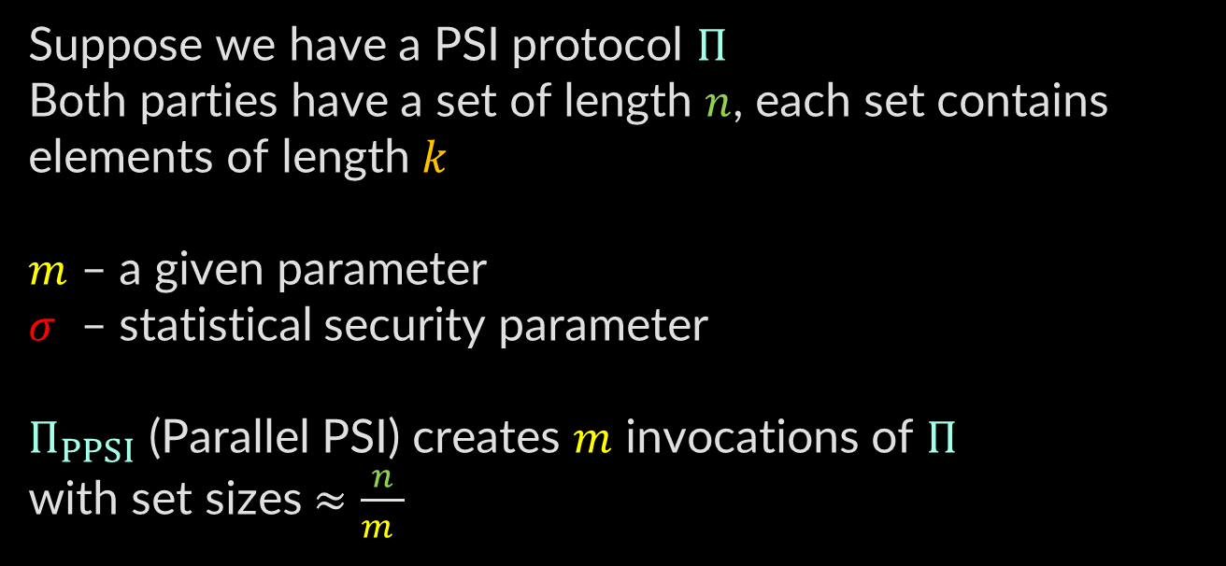
Parallelizing PSI via Binning
Balanced Allocation
Cuckoo Hashing
Data Binning
Suppose we have a PSI protocol $Π$
Both parties have a set of length $n$, each set contains elements of length $k$
$m$ – a given parameter
$σ$ – statistical security parameter
$Π_{PPSI}$ (Parallel PSI) creates $m$ invocations of $Π$
with set sizes $≈\frac{n}{m }$

Slide 64
Parallelizing PSI via Binning
Balanced Allocation
Cuckoo Hashing
Data Binning
1
Partition sets
2
Pad with dummy elements
3
PSI for smaller sets
4
Recover intersection

Slide 65
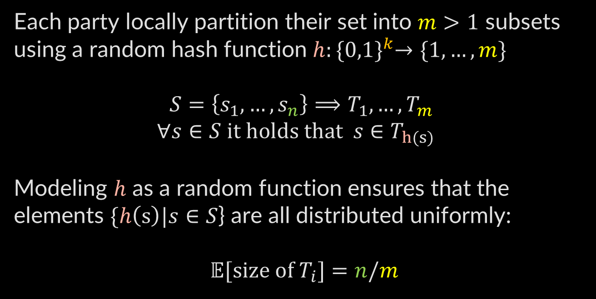
Partition Sets
Balanced Allocation
Cuckoo Hashing
Data Binning
Each party locally partition their set into $m>1$ subsets
using a random hash function $h:{\{0,1\}}^{k}→\{1,…,m\}$
$S=\left\{s_{1},…,s_{n}\right\}⟹T_{1},…,T_{m}$
$$∀s∈S it holds that s∈T_{h(s)}$$
Modeling $h$ as a random function ensures that the elements $\{h\left(s\right)|s∈S$} are all distributed uniformly:
$𝔼[size of T_{i}]=n/m$

Slide 66
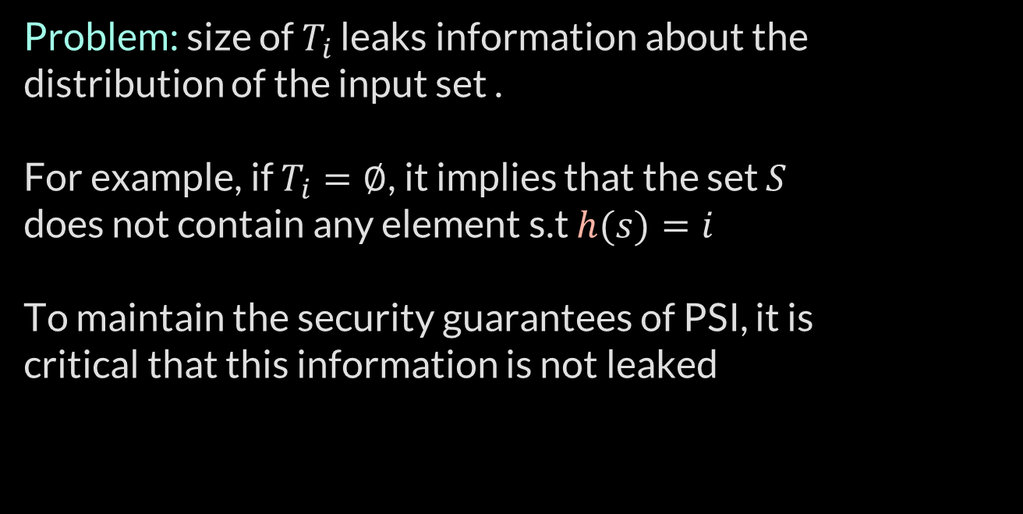
Partition Sets
Balanced Allocation
Cuckoo Hashing
Data Binning
Problem: size of $T_{i}$ leaks information about the distribution of the input set .
For example, if $T_{i}=∅$, it implies that the set $S$
does not contain any element s.t $h(s)=i$
To maintain the security guarantees of PSI, it is
critical that this information is not leaked

Slide 67
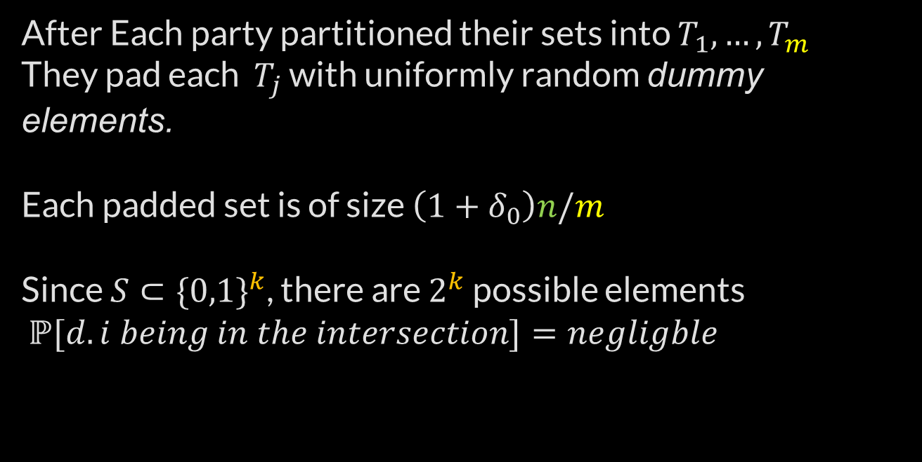
Pad With Dummy Elements
Balanced Allocation
Cuckoo Hashing
Data Binning
After Each party partitioned their sets into $T_{1},…,T_{m}$
They pad each $T_{j}$ with uniformly random dummy elements.
Each padded set is of size $\left(1+δ_{0}\right)n/m$
Since $S⊂{\{0,1\}}^{k}$, there are $2^{k}$ possible elements
$ℙ{[d.i being in the intersection]}=negligble$

Slide 68

PSI For Smaller Sets & Combine
Balanced Allocation
Cuckoo Hashing
Data Binning
The parties then engage in $m$ $parallel$ instances of $Π$,
where in the $i^{th}$ instance $π_{i}$, parties input their respective $i^{th}$ padded set.
Once all $m$ instances of $Π$ deliver output, parties then obtain the final output by simply combining these
$m$ individual outputs.

Slide 69

Analysis
Balanced Allocation
Cuckoo Hashing
Data Binning
We compute the value of the parameter $δ_{0}$ that ensures that the binning step does not fail except
with negligible probability.
for $i∈\left[n\right]$ and $j∈\{1,…,m\}$ : $X_{i,j}=1⇔s_{i}∈T_{j}$
$$\left|T_{j}\right|=X_{j}=\sum_{i∈\left[n\right]}{X_{i,j}}$$

Slide 70

Analysis
Balanced Allocation
Cuckoo Hashing
Data Binning
A Chernoff bound yields: $ℙ\left[X_{j}>\left(1+δ\right)μ\right]≤e^{−δ^{2}μ/3}$
Where $μ=𝔼[X_{j}]=n/m$ , and $0≤δ≤1$
By union bound, we see that the probability that any of the $m$ bins have more than $\left(1+δ\right)μ$ elements is $≤{me}^{−δ^{2}μ/3}$
Thus if we set the failure probability ${me}^{−δ^{2}μ/3}=2^{−σ}$
we get $δ=\sqrt{\frac{3m}{n}(σln2+lnm)}≝δ_{0}$

Slide 71

Simulation
Balanced Allocation
Cuckoo Hashing
Data Binning
We prove security via simulation paradigm, which means proving that all attacks that can be carried by an adversary in the designed protocol can be simulated in an ideal world where parties only interact with an imaginary trusted third party $ℱ_{PSI}.$
As our binning technique self-reduces PSI, we inherit the security properties of the underlying PSI protocol $Π$.

Slide 72

Simulation
Balanced Allocation
Cuckoo Hashing
Data Binning
Our $Π_{PPSI}$ protocol can call the PSI functionality $ℱ_{PSI}$,
For the sake of readability – we denote this as ${ℱ′}_{PSI}$.
We assume that $P_{0}$ to be the corrupt party.
The simulator begins by feeding $S_{0}$ to the ideal functionality $ℱ_{PSI}$ to obtain the PSI output $I^{′}=S_{0}∩S_{1}$.
Next it partitions $I^{′}$ into $m$ bins using the hash function $h$,
s.t $I_{j}=\left\{i∈I^{′} | h\left(i\right)=j\right\}$ denotes bin $j$.
If any bin $I_{j}$ has more then $\left(1+δ\right)n/m$ elements, then the simulator aborts.

Slide 73

Simulation
Balanced Allocation
Cuckoo Hashing
Data Binning
For each bin $j$, the simulator receives $P_{0}$ a padded set of size
$\left(1+δ\right)n/m$ , and returns $I_{j}$ as the output of the call to ${ℱ′}_{PSI}$.
Finally, the simulator outputs $I^{′}$.
Note that the simulation fails if
Simulator encounters binning failure
Dummy item matches the other party’s item
We conclude that the ideal world simulation is statistically indistinguishable from the hybrid-world protocol $∎$

